Slide 1
MAZE CASE STUDY EXPLANATION

Slide 2
CONTENTS OF THIS EXPLANATION
Here’s what we will go through in this presentation:
Firstly, we will see the necessary libraries that has to be imported.
So, we will go through the classes present in our code one by one.
While going through the classes we will see te working of their fucntions like what they are actually doing.
Then we will move towards the end where we will be calling the functions that we have defined in our code.
Finally we will see our main function.

Slide 3
TABLE OF CONTENTS
01
Libraries & Setup
02
Func generate_maze
03
Func draw_maze
04
Func solve_maze

Slide 4
LIBRARIES TO BE IMPORTED
Turtle
Random
1
2

Slide 5
01
Libraries & Setup

Slide 6
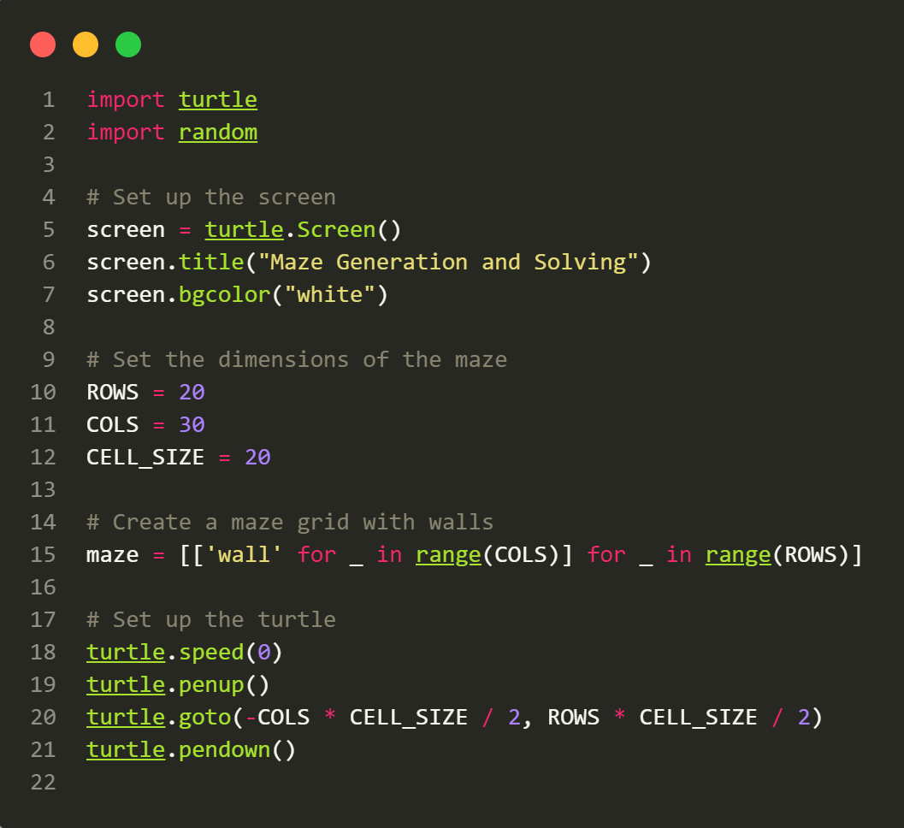

Slide 7
- Import the necessary libraries: turtle for graphics and random for randomization.
- Set up the screen for displaying the maze with a white background.
- Define constants for maze dimensions: ROWS, COLS, and CELL_SIZE.
- Create a 2D list called maze representing the maze grid, initially filled with wall cells.
- Set up the Turtle graphics, positioning the Turtle at the top-left corner of the maze.

Slide 8
02
Func generate_maze

Slide 9
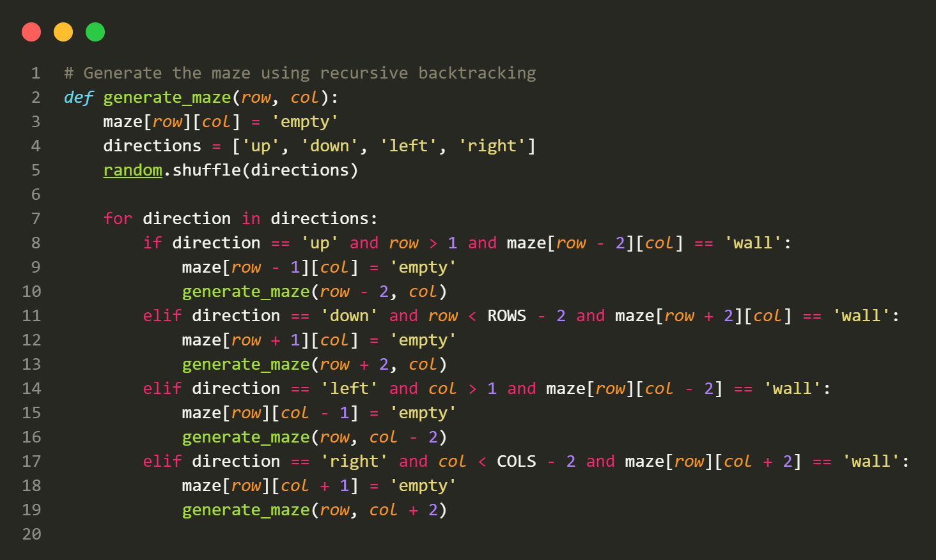

Slide 10
-Define the generate_maze(row, col) function to generate the maze using recursive backtracking. This function chooses random directions to carve paths through the walls, creating the maze.
-Start generating the maze by calling generate_maze(1, 1) from the top-left corner.
- In the generate_maze function, it shuffles the directions (up, down, left, right) randomly.
- It then tries to move in each direction to create paths through walls, ensuring it doesn't go out of bounds or overwrite existing paths.

Slide 11
03
Func draw_maze

Slide 12
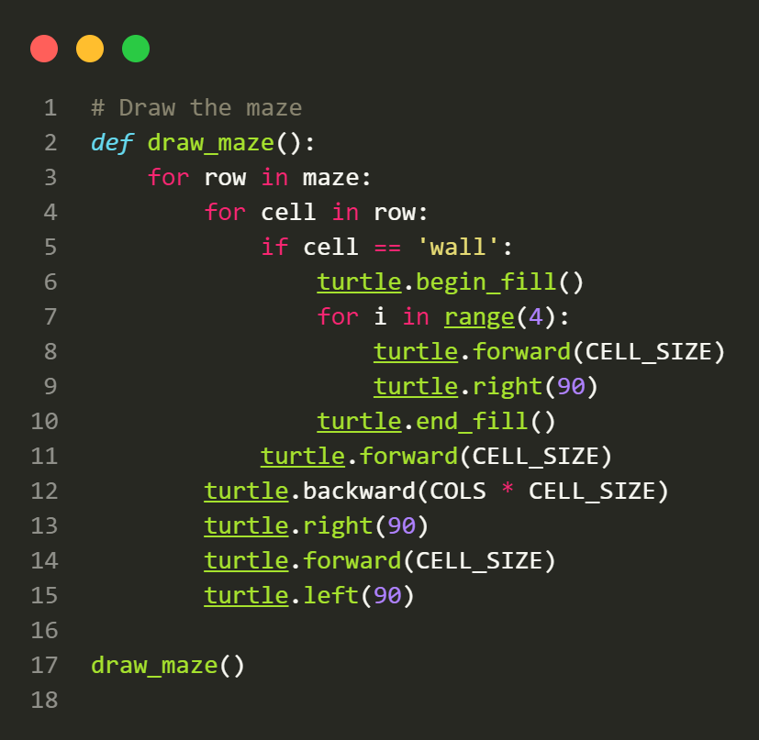

Slide 13
- After generating the maze, define the draw_maze() function to visualize it using Turtle graphics.
- Call draw_maze() to draw the maze on the screen.
- The Turtle moves through the maze grid, drawing walls as filled rectangles and moving to the next cell.
04

Slide 14
04
Func solve_maze

Slide 15
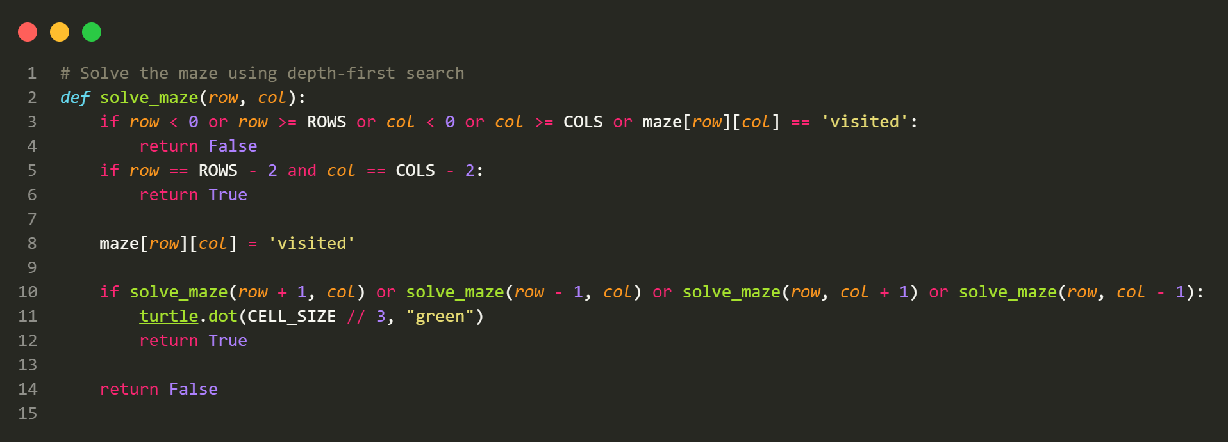

Slide 16
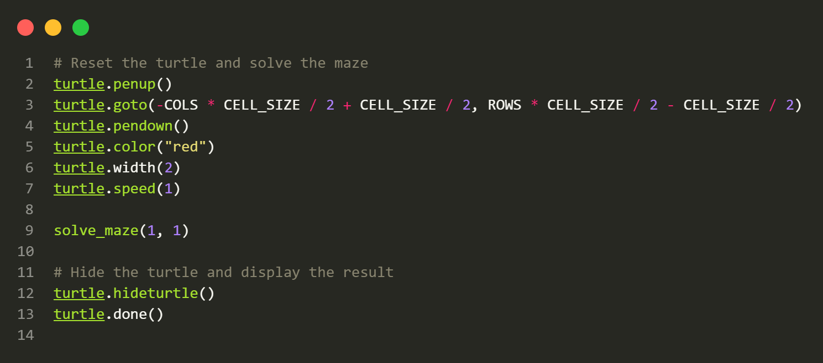

Slide 17
- Define the solve_maze(row, col) function to solve the maze using depth-first search (DFS).
- It recursively explores the maze to find a path from the start to the finish.
- When a valid path is found, it marks the path cell as visited and continues exploring.
- If it reaches the finish (bottom-right corner), it returns True.
- Call solve_maze(1, 1) to start solving the maze from the top-left corner.
- As the Turtle solves the maze, it marks the path cells with green dots.
- Reset the Turtle's position, set its color to red, and use it to mark the solved path.
- Hide the Turtle to display the final solved maze.
- The program finishes with turtle.done().

Slide 18
THANK YOU!

